Slide 1
CSCI 1145 – Unit 2
The Basics of HTML

Slide 2
Expected Learning Outcomes
Heading element, paragraph element, line break and horizontal rule, blockquote element, phrase elements
HTML Lists
Special characters on the web
Syntax validation
Structural elements
Anchor element for links

Slide 3
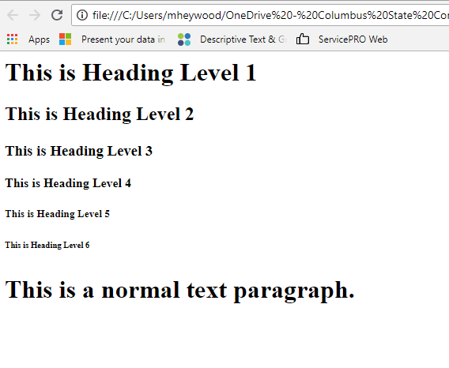
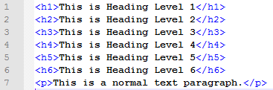
Heading Element
Heading tag is a block-level container tag that formats text display using one of six heading styles
Used to provide contrast on a page
Used for section and sub-section headings
Tags go from <h1> (largest) to <h6> (smallest)
Online example
Source - Floyd, Kevin and Kwak, Myungjae, "Web Development" (2016). Computer Science and Information Technology Grants Collections. 7. https://oer.galileo.usg.edu/compsci-collections/7 Licensed by CC-BY

Slide 4
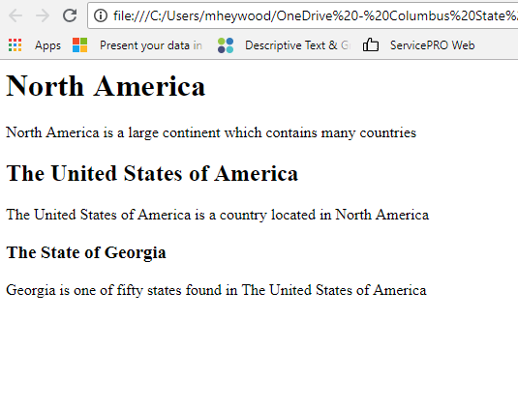
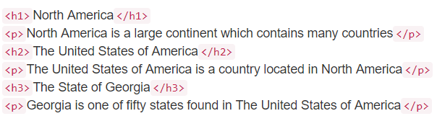
Heading Semantics
Heading tags ultimately designed to distinguish section headings for a webpage
Lower numbered headings have a higher rank
Page content should be structured with appropriate ranking
Example
Practice
Tweak the code in the left panel to see what happens in the right panel after you click “Run”
Complete the Exercises 1, 3, and 4 from the HTML Headings exercises – W3Schools Headings
Write a short poem with a heading – Khan Academy Challenge
Source - Floyd, Kevin and Kwak, Myungjae, "Web Development" (2016). Computer Science and Information Technology Grants Collections. 7. https://oer.galileo.usg.edu/compsci-collections/7 Licensed by CC-BY - HTML Examples from W3Schools.com, copyright Refsnes Data - "Intro to HTML/CSS: Making webpages" by Kahn Academy is licensed under CC BY 4.0

Slide 5
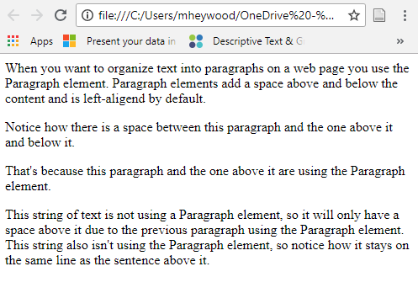
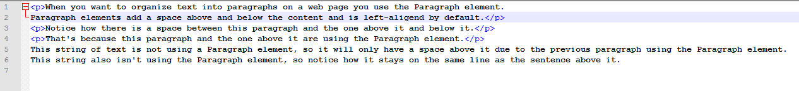
Paragraph Element
HTML provides a way for content to be marked as a paragraph
Paragraphs on the web place a blank line before and after the content
Left aligned by default
Container and block-level element
Tags are <p>content goes here</p>
Online example
Example
Practice
Tweak the code in the left panel to see what happens in the right panel after you click “Run”
Complete Exercise 1 and 2 from the HTML Paragraphs exercises– W3Schools Paragraphs
Remove the <p> tags to see what happens to the text formatting – Khan Academy The p tag
Source - Floyd, Kevin and Kwak, Myungjae, "Web Development" (2016). Computer Science and Information Technology Grants Collections. 7. https://oer.galileo.usg.edu/compsci-collections/7 Licensed by CC-BY - HTML Examples from W3Schools.com, copyright Refsnes Data - "Intro to HTML/CSS: Making webpages" by Kahn Academy is licensed under CC BY 4.0

Slide 6
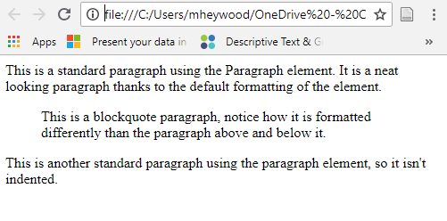
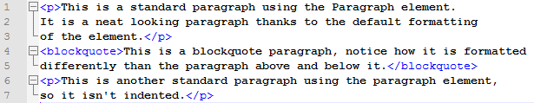
Blockquote Element
Used to indent a block of text for emphasis
Similar to a quoted citation in a magazine or print
Provides ~40 pixels of indentation from left and right margins
Container tag, block-level element - <blockquote></blockquote>
Enclosed text word wrapped with a blank line above and below
Online example
Example
Practice
Tweak the code in the left panel to see what happens in the right panel after you click “Run”
Complete Exercise 2 from the HTML Quotations exercises- W3Schools Blockquote
Source - Floyd, Kevin and Kwak, Myungjae, "Web Development" (2016). Computer Science and Information Technology Grants Collections. 7. https://oer.galileo.usg.edu/compsci-collections/7 Licensed by CC-BY - HTML Examples from W3Schools.com, copyright Refsnes Data

Slide 7
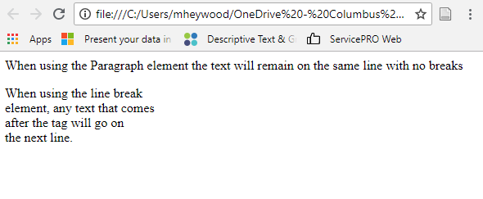

Line Breaks
Cause browser to end a line of text and to continue on the next line
Don’t provide a blank space above and below the element like <p>
Tag is <br> so it is an empty element
Online example
Example
Practice
Tweak the code in the left panel to see what happens in the right panel after you click “Run”
Complete Exercise 3 from the HTML Paragraphs exercises – W3Schools Line Break
Practice by adding a new paragraph with <br> tags mixed in it before the YouTube link code – Khan Academy The br tag
Additional hands-on practice with <br> - MDN web docs The Line Break Element
Source - Floyd, Kevin and Kwak, Myungjae, "Web Development" (2016). Computer Science and Information Technology Grants Collections. 7. https://oer.galileo.usg.edu/compsci-collections/7 Licensed by CC-BY - HTML Examples from W3Schools.com, copyright Refsnes Data - "Intro to HTML/CSS: Making webpages" by Kahn Academy is licensed under CC BY 4.0 - "Learning HTML: Guides and Tutorials" by Mozilla Developers Network is licensed under CC BY-SA 2.5

Slide 8
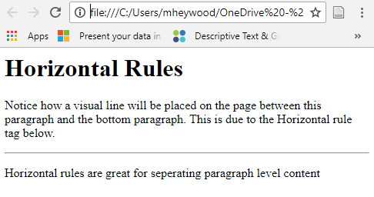
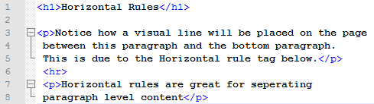
Horizontal Rules
Used for paragraph level content to create visual separation on the web page
HTML 5 prescribes their use when a thematic break among content is required
Tag is <hr>
Online example
Example
Practice
Tweak the code in the left panel to see what happens in the right panel after you click “Run”
Complete Exercise 2 from the HTML Headings exercises– W3Schools Horizontal Rule
Source - Floyd, Kevin and Kwak, Myungjae, "Web Development" (2016). Computer Science and Information Technology Grants Collections. 7. https://oer.galileo.usg.edu/compsci-collections/7 Licensed by CC-BY - HTML Examples from W3Schools.com, copyright Refsnes Data

Slide 9
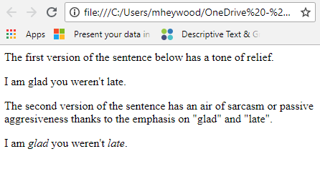
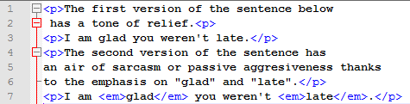
Phrase Elements
Inline text semantics used to define meaning, structure, or style of a word, line, or an arbitrary piece of text
Tags include but are not limited to - <em>, <strong>, <i>, <b>, <u> - Full list (scroll to Inline Text section)
Online example
Example
I am glad you weren’t late. vs. I am glad you weren’t late.
Tone is different making the context different thanks to the emphasis on glad and late
Coded Version
Practice
Tweak the code in the left panel to see what happens in the right panel after you click “Run”
Complete all five Exercises from the HTML Formatting exercises – W3Schools HTML Text Formatting
Watch the linked video to see how phrase elements can change the semantics and look of text – Khan Academy Text emphasis
Sources - HTML Examples from W3Schools.com, copyright Refsnes Data - "Intro to HTML/CSS: Making webpages" by Kahn Academy is licensed under CC BY 4.0 - "Learning HTML: Guides and Tutorials" by Mozilla Developers Network is licensed under CC BY-SA 2.5

Slide 10
HTML Lists
Used to structure text in the form of lists
Three types of HTML Lists
Unordered list - Bulleted items
Ordered list - Numbered items
Definition list - Lists of terms and definitions
Unordered list rendered with bulleted items on single-spaced lines of text
Ordered list rendered with numbers, letters, or numerals on single-spaced lines of text
Definition list is similar in display to a series of blockquoted paragraphs
Source - Floyd, Kevin and Kwak, Myungjae, "Web Development" (2016). Computer Science and Information Technology Grants Collections. 7. https://oer.galileo.usg.edu/compsci-collections/7 Licensed by CC-BY

Slide 11
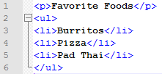
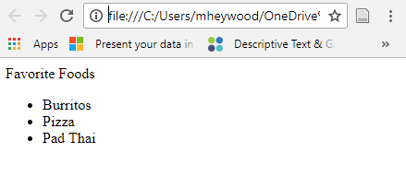
Unordered Lists
Series of items preceded by bullet characters and set off from surrounding text by blank lines
Single spaced and indented from left margin
Should be used when list item order is unimportant
Block-level container tag type, can be nested
Tag is <ul></ul>
Contains the list item tag <li></li>
Represents the items in the list
Online example
Practice
Tweak the code in the left panel to see what happens in the right panel after you click “Run”
Complete Exercises 1 and 3 from the HTML Lists exercises– W3Schools Unordered Lists
Scroll to the Lists section and complete the Active learning: Marking up an unordered list module – MDN WebDocs
Source - Floyd, Kevin and Kwak, Myungjae, "Web Development" (2016). Computer Science and Information Technology Grants Collections. 7. https://oer.galileo.usg.edu/compsci-collections/7 Licensed by CC-BY
Example

Slide 12
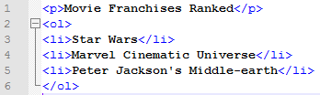
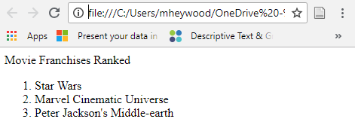
Ordered Lists
Series of items preceded by sequence numbers and set off from surrounding text by single blank lines
Single spaced and indented from left margin
Should be used when list item order is important
Block-level container tag type, can be nested
Tag is <ol></ol>
Contains the list item tag <li></li>
Represents the items in the list
Online example
Practice
Tweak the code in the left panel to see what happens in the right panel after you click “Run”
Complete Exercises 2 and 4 from the HTML Lists exercises – W3Schools Ordered Lists
Scroll to the Lists section and complete the Active learning: Marking up an Ordered list module – MDN WebDocs
Source - Floyd, Kevin and Kwak, Myungjae, "Web Development" (2016). Computer Science and Information Technology Grants Collections. 7. https://oer.galileo.usg.edu/compsci-collections/7 Licensed by CC-BY
Example

Slide 13
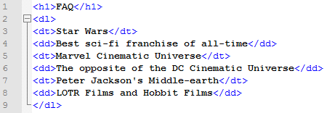
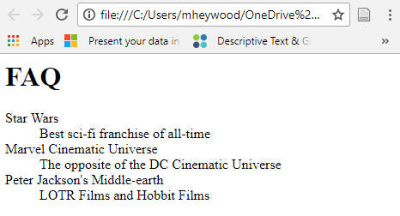
Definition Lists
Series of terms and definitions offset from surrounding text by blank lines
Terms in list are blocked at the left margin, definitions indented and word wrapped on following lines
Should be used for defining terms or a FAQ style page
Tag is <dl></dl>
Contains the <dt></dt> definition term tag
Contains the <dd></dd> definition description tag
Online example
Practice
Tweak the code in the left panel to see what happens in the right panel after you click “Run”
Complete Exercise 5 from the HTML Lists exercises – W3Schools Definition Lists
Source - Floyd, Kevin and Kwak, Myungjae, "Web Development" (2016). Computer Science and Information Technology Grants Collections. 7. https://oer.galileo.usg.edu/compsci-collections/7 Licensed by CC-BY
Example

Slide 14
Special Characters in HTML
<, >, “, ‘ and & are considered special characters
Due to them being a part of HTML syntax itself
Must use character references for them to display properly on a web page
All start with (&) and end with (;)
Most commonly used Character Entities
Other useful character entities (scroll to bottom)
Sources - "Learning HTML: Guides and Tutorials" by Mozilla Developers Network is licensed under CC BY-SA 2.5
Literal character | Character reference equivalent
< | &lt;
> | &gt;
“ | &quot;
‘ | &apos;
& | &amp;

Slide 15
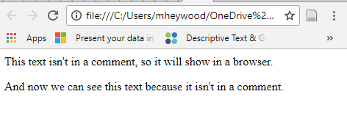
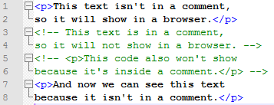
HTML Comments
Purpose is to describe how code works, describe what the code does etc.
Useful for future code maintenance or if you hand code off to a new developer
Comments are ignored by the browser and invisible to the user
Syntax - <!- - Comment goes here - ->
Online example
Practice
Tweak the code in the left panel to see what happens in the right panel after you click “Run”
Complete Exercises 1 and 2 from the HTML Comments exercises – W3Schools HTML Comments
Sources - "Learning HTML: Guides and Tutorials" by Mozilla Developers Network is licensed under CC BY-SA 2.5
Example

Slide 16
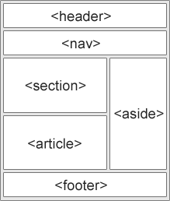
HTML 5 Semantic Layout Elements
HTML 5 includes a set of semantic document layout tags to define different parts or structure of a web page.
Most common layout elements
<header> - container for page heading content such as logo, site name, etc.
<nav> - used to define navigation links or menus
<main> - container for major page content that isn’t repeated in other parts of the page
<section> - defines generic sections of thematic grouping in a web page
<article> - represents a complete, or self-contained, composition in a web page that is, in principle, independently distributable or reusable
<aside> - defines content aside from the content it is placed in
<footer> - defines footer information for entire web page such as copyright information, links, logos, etc.
Online example – Review the HTML code on left side to see how the content is organized with the structural elements. The CSS above the HTML code is what makes the output look the way it does, while the elements provide structure for the content.
Source - Floyd, Kevin and Kwak, Myungjae, "Web Development" (2016). Computer Science and Information Technology Grants Collections. 7. https://oer.galileo.usg.edu/compsci-collections/7 Licensed by CC-BY

Slide 17
Non-semantic Layout Elements
Not all situations are ideal for semantic layout elements to group content together
Sometimes you may want to group a set of elements together to affect them all as a single entity with some CSS or JavaScript
These cases may be best suited for the <div> and <span> elements
<span> - inline non-semantic element that can target specific content
Provides no visual change by itself, needs CSS
<div> - block-level non-semantic container element that defines a division or section of a document
Often used as a container for other HTML elements to style them with CSS or execute JavaScript tasks
Sources - "Learning HTML: Guides and Tutorials" by Mozilla Developers Network is licensed under CC BY-SA 2.5

Slide 18
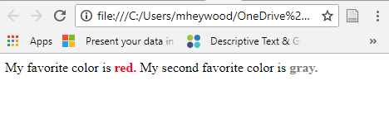

Span Element
Online example
Example
Practice
Tweak the code in the left panel to see what happens in the right panel after you click “Run”
Use the existing code as an example to create a new paragraph under the existing one to list your two favorite colors – W3Schools Span
Source - HTML Examples from W3Schools.com, copyright Refsnes Data

Slide 19
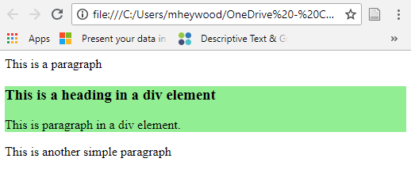
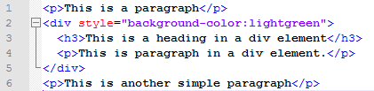
Div Element
Online example
Example
Practice
Tweak the code in the left panel to see what happens in the right panel after you click “Run”
Use the existing code as an example to create a new div under the existing one to explain your favorite movie. Include a heading element and a paragraph element in the div – W3Schools Div
Source - HTML Examples from W3Schools.com, copyright Refsnes Data

Slide 20
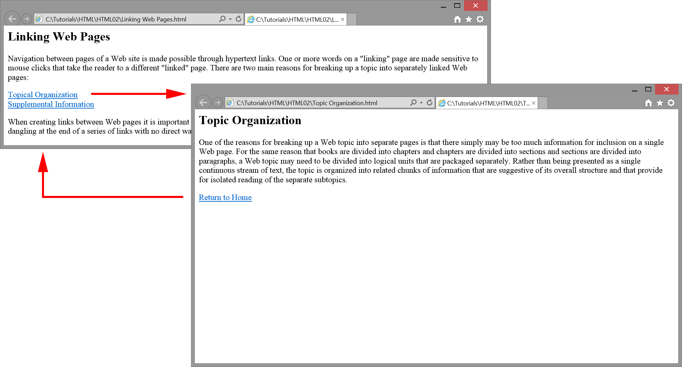
Hyperlinks
Allow navigation from one web page to another, or to any other linkable resource such as images, videos, apps, and anything else that can live on the World Wide Web
Typically created by turning text into a “hot spot” that when clicked will open the linked web resource
Can be single or multiple words, or a block of elements
Images can be turned into links too
When linking amongst a site’s pages, all pages should have return links via a menu or text that can return the user to the page they came from
Source - Floyd, Kevin and Kwak, Myungjae, "Web Development" (2016). Computer Science and Information Technology Grants Collections. 7. https://oer.galileo.usg.edu/compsci-collections/7 Licensed by CC-BY

Slide 21
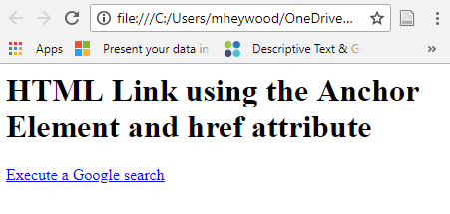
Anchor Element
Anchor element along with its attributes are what create a hyperlink
Classified as a container and inline-level tag
Tag is <a></a>
href attribute of Anchor element is required
Hypertext reference – path to the linked file
target attribute toggle how link opens
target=“_blank” will open the link in a new tab or window
Online example, target example
Practice
Tweak the code in the left panel to see what happens in the right panel after you click “Run”
Complete Exercise 1 from the HTML Links exercises – W3Schools HTML Links
Scroll to the “Active learning: creating your own example link” section and follow the directions. You can create content related to your favorite movie, and then link to that movie’s IMDB page if you’d like. – MDN Web Docs Creating Hyperlinks
Source - - Floyd, Kevin and Kwak, Myungjae, "Web Development" (2016). Computer Science and Information Technology Grants Collections. 7. https://oer.galileo.usg.edu/compsci-collections/7 Licensed by CC-BY
HTML Examples from W3Schools.com, copyright Refsnes Data - "Learning HTML: Guides and Tutorials" by Mozilla Developers Network is licensed under CC BY-SA 2.5
Example

Slide 22
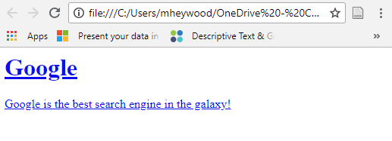
Block Level Links
Any content can be turned into links, including block level elements
Could be an image, headings, a paragraph, or a div, so any block level elements can be turned into a link
Example
<a href=“https://google.com”>
<h1>Google</h1>
<p>Google is the best search engine in the galaxy!</p>
</a>

Slide 23
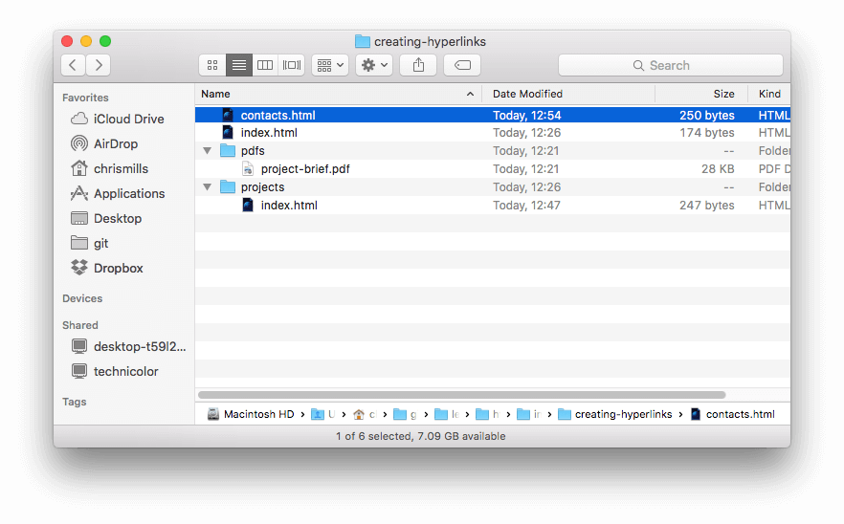
URLs and Paths
The href value for most anchor elements to create a hyperlink is typically a URL
The URLs use paths to find a web file in a web server’s filesystem
E.g., Mozilla’s English homepage file is found at https://www.Mozilla.org/en-US/
The path implies that an index.html file is located on a Mozilla server under the en-US directory
If you know the path to a web file on a web server it can be linked
The type of link to access web files depends on where you are linking out from
Web Server Directories Example
Source - "Learning HTML: Guides and Tutorials" by Mozilla Developers Network is licensed under CC BY-SA 2.5

Slide 24
3 Types of Hyperlinks
3 main types of hyperlinks are used on the web
Relative links - for local linking on your own website server
Can’t be used to link to files that reside on a remote server
Absolute links - for remote linking to files on external websites
Can also be used to link to local files
Fragment identifiers aka bookmark links – for linking to a specific section of an HTML document
Linking best practices
Relative links should be used to link to files that reside on the same web server as your website files. For example, a website’s menu would use relative links since all of the main pages are more than likely stored on the same server in a common directory.
Absolute links have to be used to link to web files that reside on remote servers. For example, if you want to link to Google’s homepage from your own website, you would have to use an Absolute link. These links can also be used to link to your local web files too though.

Slide 25
Relative Links
Local URL that links to content on your own website
URL will depend on the directory structure of your web server
In this example the creating-hyperlinks directory would be called the “root” directory. In its root it has 2 HTML files and two sub-directories with files.
If you wanted to link to the index.html file under the “projects” directory from the contacts.html file under the “root” directory the URL would be:
projects/index.html
If you wanted to link to the index.html file found under “root” from the contacts.html file the URL would be:
index.html
If you wanted to link to the contacts.html file from the index.html file that is under the “projects” directory the URL would be:
../contacts.html
The “..” command can be strung together if the link needs to traverse multiple sub-directories to get to the source file
Local Web Server Directories Example
Practice
Tweak the code in the left panel to see what happens in the right panel after you click “Check Your Code”
Complete the Relative Link exercise in HTML Links exercises from W3Schools
Source - "Learning HTML: Guides and Tutorials" by Mozilla Developers Network is licensed under CC BY-SA 2.5 - HTML Examples from W3Schools.com, copyright Refsnes Data

Slide 26
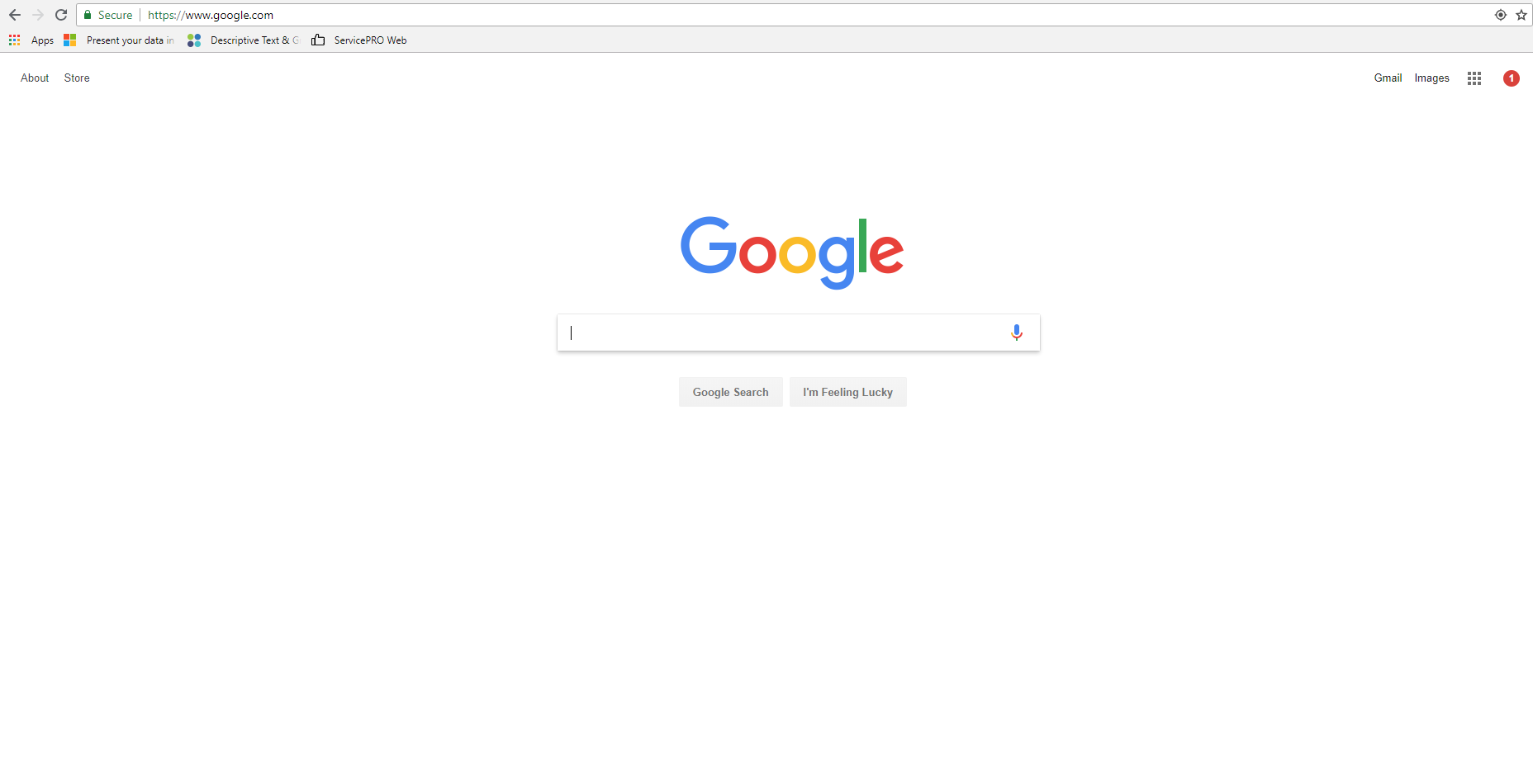
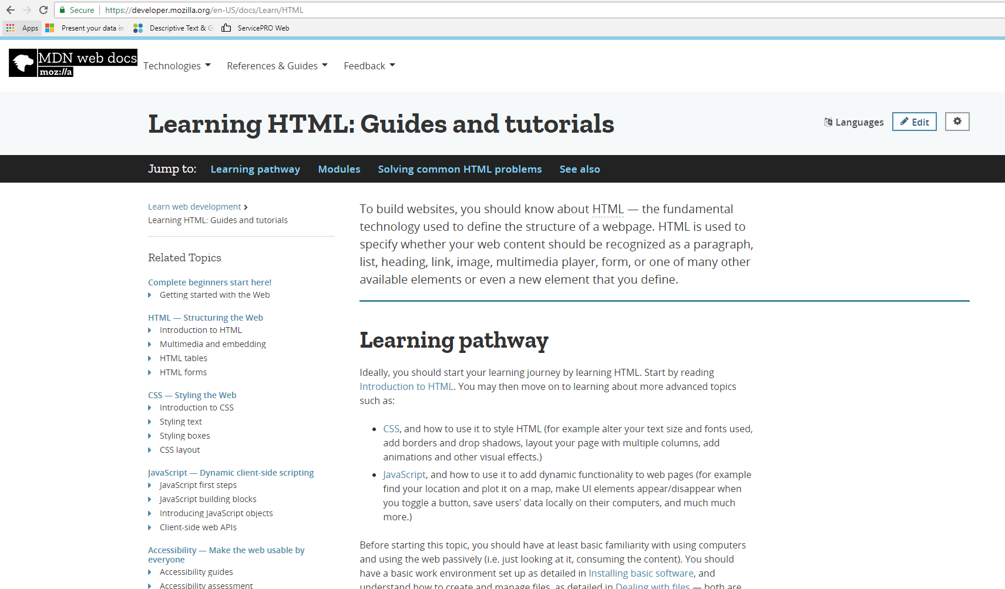
Absolute Links
URL that requires an absolute location on the web, including protocol and domain name
Must be used to link to remote web pages on remote web servers
Can also be used to link to local web pages on a local web server
Although it’s recommended to use Relative links whenever possible
In the top example the Absolute link to reach Google’s homepage if you were linking to it from your own web page would be:
https://www.google.com
In the bottom example the absolute link to reach Mozilla’s HTML tutorials if you were linking to it from your own web page would be:
https://developer.mozilla.org/en-US/docs/Learn/HTML
This URL implies that the web page file you see is stored on the developer.Mozilla.org domain’s web server’s file system under the en-US/docs/Learn/HTML directories
Note that en-US, docs, Learn, and HTML are all directories themselves, so the actual web page file you see to the right would be saved under the HTML directory
If the filename isn’t included in the full URL browsers will automatically load any web file named default.html or index.html
Practice
Tweak the code in the left panel to see what happens in the right panel
Complete the Khan Academy Links you love challenge – Khan Academy Links you Love
Source - "Learning HTML: Guides and Tutorials" by Mozilla Developers Network is licensed under CC BY-SA 2.5 - Intro to HTML/CSS: Making webpages" by Kahn Academy is licensed under CC BY 4.0

Slide 27
Fragment Identifiers
This type of link can be used to link to a specific part of an HTML document, rather than just to the top of the document
Can also be used to link to a specific section of a document from within the document itself
Requires the use of the <a> element, and the “id” attribute
The “id” attribute is what is used to create the link-to point in a particular document
The <a> is used to provide the text to click on to make the jump to the “id”
Example
<h2 id=“mailingaddress”>Mailing Address</h2> - This code establishes the section where the Fragment Identifier will jump to on a document when the links below are clicked.
<p>Want to write us a letter? Use our <a href=“contacts.html#mailingaddress”>mailing address</a>.</p> - This code when clicked would take the user to the contacts.html page, directly to the Mailing Address heading established in #1 above.
<p> The <a href=“#mailingaddress”>company mailing address</a> can be found at the bottom of this page.</p> - This code when clicked would take the user to the bottom of the page, directly to the Mailing Address heading established in #1 above.
Practice
Tweak the code in the left panel to see what happens in the right panel after you click “Run”
Try altering the code on the left panel so that the Jump to Chapter 4 link reads Jump to Chapter 11. Then change the href value on the left panel to #C11. Delete the id for the Chapter 4 heading on the left panel, and then add a new id to the heading for Chapter 11 with a value of #C11. Run the changes to see if the link now jumps to Chapter 11. – W3Schools Links
Complete the Khan Academy Jump around challenge – Khan Academy Challenge Jump Around
Source - "Learning HTML: Guides and Tutorials" by Mozilla Developers Network is licensed under CC BY-SA 2.5 - HTML Examples from W3Schools.com, copyright Refsnes Data - Intro to HTML/CSS: Making webpages" by Kahn Academy is licensed under CC BY 4.0

Slide 28
E-mail Hyperlinks
This type of link, when clicked, opens a new outgoing email message rather than linking to a resource or a web page.
Require the <a> element and the mailto: URL scheme
Example
<a href=“mailto:nowhere@Mozilla.org”>Send email to nowhere</a>
This code results in: Send email to nowhere (click to see what happens)
The email address itself isn’t required, just mailto:
This method would open a new outgoing email window with no address filled in
In addition to the email address you can use any standard mail header fields such as “subject”, “cc”, and “body” (not a true header but will specify short content message).
E.g., mailto:nowhere@mozilla.org?cc=nobody@mozilla.org or mailto:nowhere@mozilla.org?cc=nobody@mozilla.org&subject=This%20is%20the%20subject
Practice
Tweak the code in the left panel to see what happens in the right panel after you click “Run”
Using the example code, create a new email link with your own email address and a subject of I can do this!. After you run the changes, click on the new Send Mail link in the right panel to send yourself an email. – W3Schools Email Link
Source - "Learning HTML: Guides and Tutorials" by Mozilla Developers Network is licensed under CC BY-SA 2.5 - HTML Examples from W3Schools.com, copyright Refsnes Data

Slide 29
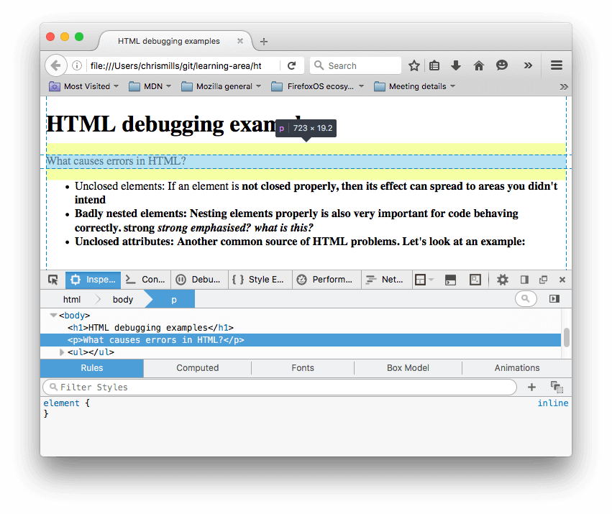
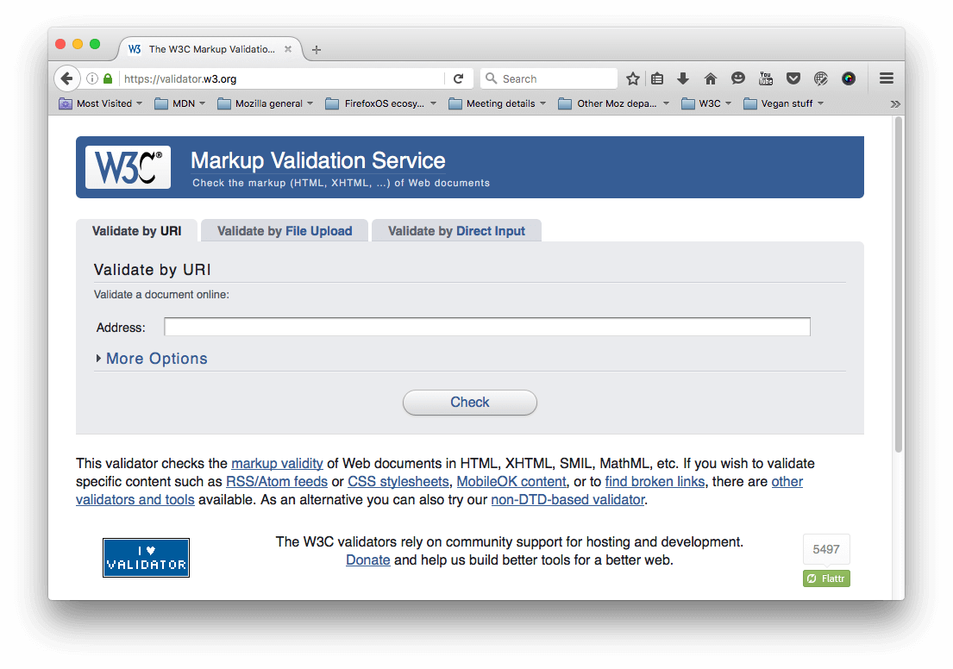
HTML Debugging and Validation
Browser Developer Tools
HTML is parsed permissively by browsers, unlike a true programming language such as Java, which needs to be compiled before the code will run to ensure there are no syntax errors.
Means web pages will still display even with syntax errors, which is both a good and bad thing
Good because anyone can pretty much get content published
Bad because certain syntax errors can cause the content to not display properly or break other aspects of the site
For pages with minimal HTML code, self-debugging with a browser’s Developer Tools should suffice for finding syntax issues
Learn more about browser Developer tools (invaluable for any level of web developer)
For pages and sites with large amounts of code, an online validator is the best option
Markup Validation Service – hosted by the W3C
Can scan via URL, File Upload, or Direct Input
Source - "Learning HTML: Guides and Tutorials" by Mozilla Developers Network is licensed under CC BY-SA 2.5
Online Validator

Slide 30
HTML Debugging and Validation Cont.
Practice
Complete Steps 1-7 under the “Active Learning: Studying permissive code” section – MDN web docs – Debugging HTML
Correct the errors that are pointed out to see how the changes will affect the look of the page
Complete Steps 1-4 under the “Active Learning: Validating an HTML document section – MDN web docs – Debugging HTML
Make sure to fully interpret the reported errors
Once complete try running your favorite website’s homepage through the validator to see if it has errors
Source - "Learning HTML: Guides and Tutorials" by Mozilla Developers Network is licensed under CC BY-SA 2.5

Slide 31
Unit 2 Study Guide
You can take advantage of the Quizlet app for a Unit 2 Study Guide below:
Unit 2 Study Guide on Quizlet

